Slide 1
Module 14

Slide 2
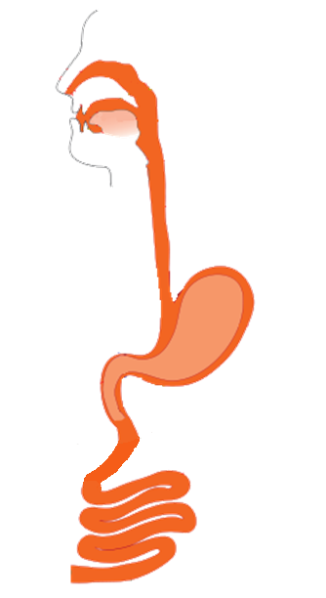

TRANSPORTATION
We saw that,
Food taken in
Broken down into simple substances
Blood carries them to all the cells of the body.
Absorbed in Blood

Slide 3
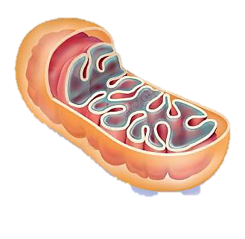
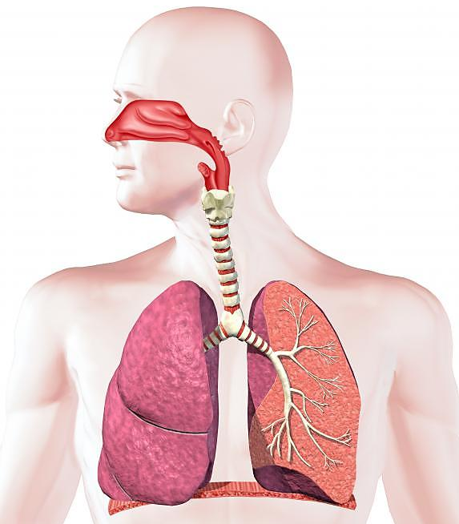

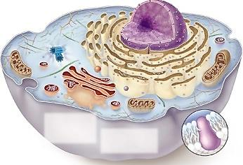
Similarly
Oxygen that enters the lungs is carried to the cells by blood.
H₂O
CO₂
O₂
Glucose
O₂
O₂
O₂
O₂
O₂
O₂
O₂
O₂

Slide 4
So we can say that,
A substance synthesized or absorbed in one part of the body moves to other parts of the body
This process is known as transportation.
Produced.

Slide 5
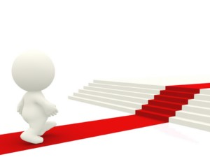
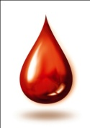

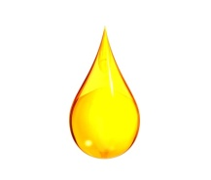
This transport in human beings is called as circulation.
The process of circulation requires some medium.
In human beings there are two such media.
CIRCULATION
BLOOD
LYMPH
A pumping organ is needed to
push the blood around the body
along with a network of tubes
to reach all the tissues
A system to repair the damage from time to time if it is damaged
Blood is a fluid connective tissue

Slide 6
Thank You

